Slide 1
Islamic Microfinance, Shadow Banking and Prospects and opportunity
Dr Bill Kiwia
Lecturer, Head of Banking and Financial Services
Institute of Finance Management
2017

Slide 2
Course outline
Islamic Financial System
Structure of the Islamic Microfinance.
Opportunities in Financial Sector.
Shadow Banking Growth in Tanzania.
Islamic Microfinance and Financial Inclusion
Conclusion

Slide 3
Islamic Financial System
Financial system is an organised mechanism that facilitates the process of exchanging financial claims between economic entities.
It is a financial system which is based on non-interest principles and more on equity based financial practices to be in compliance with Islamic Sharia Law.
Islamic Financial System dated to 1960s with pioneering experiment by Egypt scholars which paved way to the establishment of Mit-Ghamr Islamic Saving Association that was functioning as a financial institution and provide return to investors but from non-compliant sharia financial instruments.

Slide 4
Islamic Financial System
This is an area that is rapidly growing fast in the international financial system (It is estimated that the growth rate is 20 p.a.- IMF 2015)
The search for an alternative financing system started early 1900 (Iqbal, 2012).
The major concern was on the interest charge on securities (Iqbal, 2012). The early researchers in 1950s suggest that there was a problem in the conventional system and Islamic principles of economics offers an alternative solution.

Slide 5
Islamic Microfinance
Microfinance essentially is a thrift institution providing financial services to those group of individuals who are excluded from the main stream financial institutions.
Microfinance involves providing financial services to the poor and those who are not having access to such services.
Islamic microfinance essentially is non-interest based micro finance services to the poor. It combines equity based financing and trade based financing with element of charitable support.

Slide 6
Framework for Islamic Microfinance Structure
Financial Products:
Bai Salaam
Murabaha
Bai Muajjal
Ijarah
Istisna
Mudaraba.
Musharaka.
Framework and Structure of Operations:
The source of funds:-
Charitable (waqf, zakat, sadaqa)
Investment capital

Slide 7
Microfinance in Tanzania
Since 2001 microfinance policy was introduced to advocate more wider outreach of the population to provide innovative financial services to those who are excluded from mainstream financial sector.
Main stream banks also joined also the band wagon by open a window aimed at providing microfinance services to the community (e.g. NMB, CRDB, Akiba etc.)

Slide 8
Microfinance and Shadow Banking in Tanzania
 | Use bank product | Use only non bank product | Use informal mechanisms only | excluded
2013 | 13.80% | 43% | 15.80% | 27.40%
2009 | 9.10% | 6.70% | 28.80% | 55.50%
Finscope Survey (2013)

Slide 9
Cont…
Finscope Survey (2013)
Category | 2009 | 2010 | 2011 | 2012 | 2013
Internet banking (TZS million.) | 8130 | 10420 | 12040 | 17768 | 22725
Mobile (SMS) banking | 124 | 155 | 224 | 302 | 587
Mobile payment system | 158538 | 1006430 | 5563281 | 17407726 | 28852294
(ATM) value of transaction( TZS billion) | 7747 | 8200 | 9642 | 5279 | 7637
( POS) value of transaction( TZS billion) | 1149 | 279 | 203 | 198 | 347

Slide 10
Cont…
Finscope Survey (2013)
 | Use bank product | Use only non bank product | Use informal mechanisms only | excluded
Employed formally | 78.6 | 18.4 | 1.10% | 1.90%
Own business | 19.60% | 53.40% | 11.00% | 16.00%
Subsistence farmer | 4.90% | 36% | 23.50% | 35.50%
Agribusiness | 7.10% | 39.50% | 21.00% | 32.50%

Slide 11
Cont…
 | Use bank product | Use only non bank product | Use informal mechanisms only | excluded
Kilimanjaro | 16.8 | 70.1 | 6.9 | 6.2
Dar es salaam | 31.6 | 53.8 | 4.8 | 9.8
Njombe | 16.4 | 50.3 | 23.1 | 10.3
Morogoro | 17.3 | 46.5 | 23.7 | 12.4
Iringa | 25.9 | 39.5 | 19 | 15.6
Manyara | 5.4 | 36.1 | 42.4 | 16.1
Finscope Survey (2013)

Slide 12
Cont..
 | Use bank product | Use only non bank product | Use informal mechanisms only | Excluded
Zanzibar | 11.5 | 25.5 | 17.1 | 45.9
Singida | 7 | 34.9 | 12.3 | 45.8
Lindi | 6.2 | 35 | 14.6 | 44.1
Mtwara | 7.4 | 35.4 | 13.4 | 43.8
Mbeya | 6.6 | 42 | 9.4 | 42
Shinyanga | 12 | 32 | 14.5 | 41.5
Finscope Survey (2013)

Slide 13
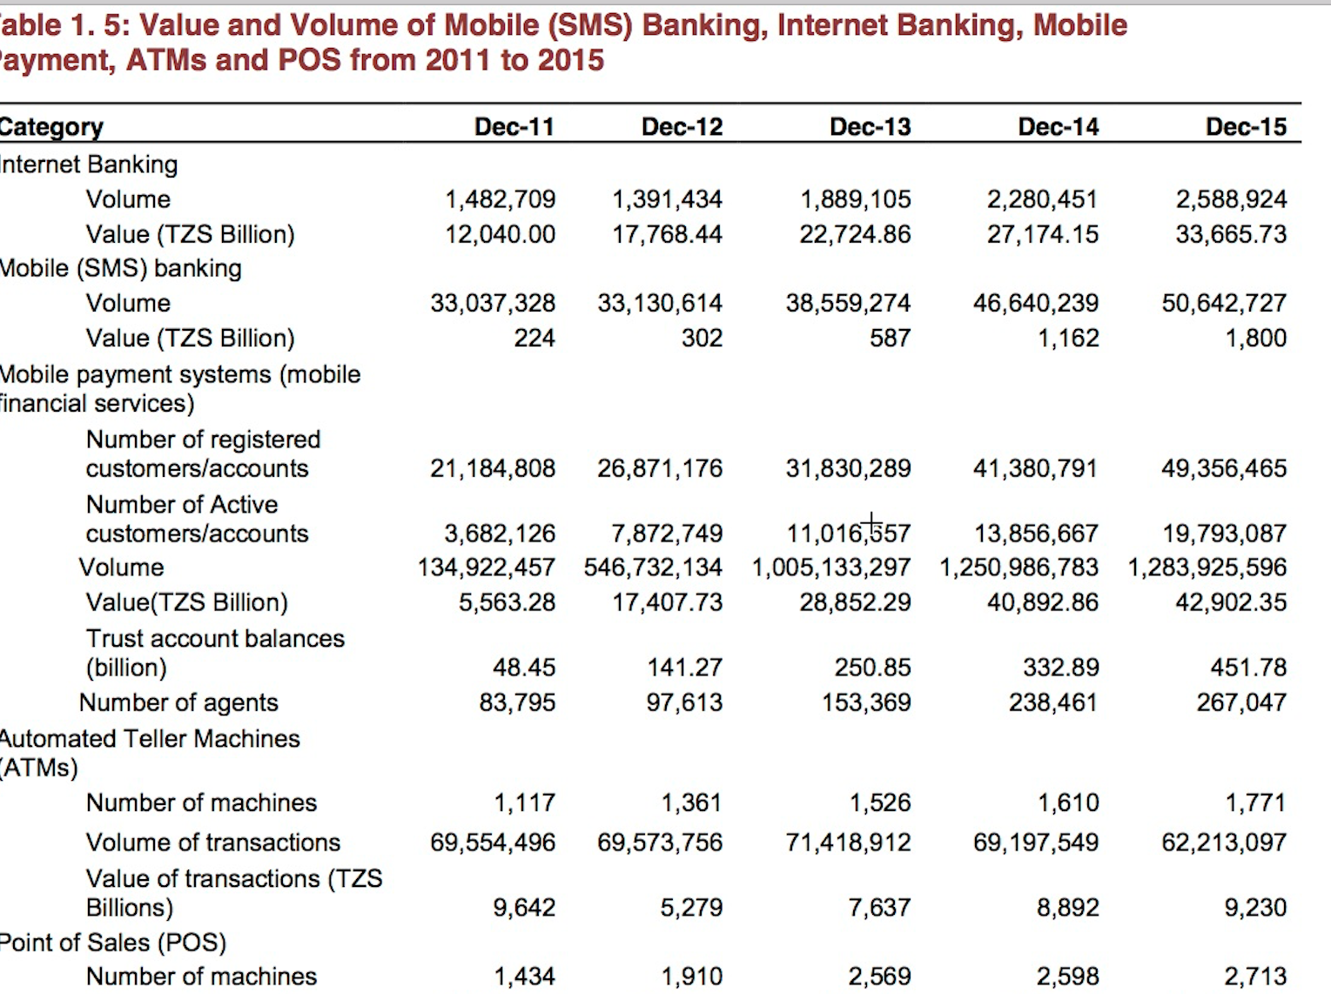

Slide 14
Finscope Survey 2013

Slide 15
Islamic Microfinance and Financial Inclusion
A cultural and interest free bankable product.
Equity participation and business growth.
Value chain financing.
Ethical business relationship (e.g. official acceptance of late payment and lower cost of transactions (e.g. Pakistani Islamic Microfinance Institutions) (Bill and Melinda Gates, 2015).
Offer an opportunity to include more members into formal financial services).

Slide 16
Conclusion
Thanks for Listening

